Slide 1
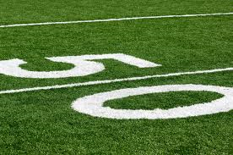

Touchdowns for Teamwork!
Allison Butts
South District Sentinel
2013-2014

Slide 2

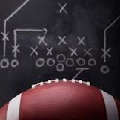

What is a Team?
A group that comes together to achieve a common goal
Maximizes strengths and Minimizes weaknesses of individuals
Allows common people to reach uncommon goals

Slide 3
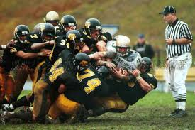

T-E-A-M
T- together
E- everyone
A- achieves
M- more

Slide 4
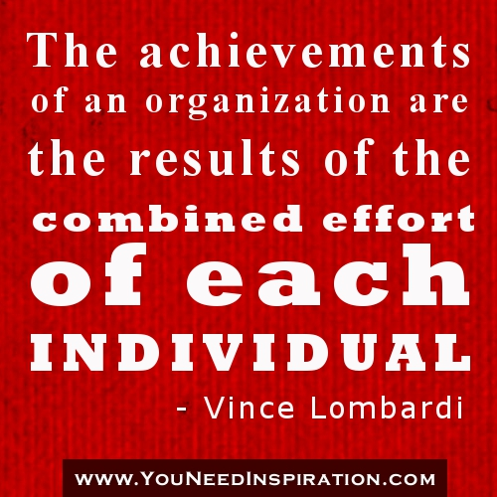

Be a Team Player!
What makes a Team
      Common goals
      Equality
      Recognition
      Positive Discussions
      Good communication

Slide 5
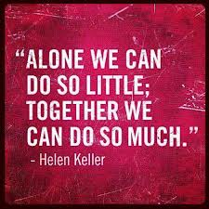
Why is a Team Important?
Support
Encouragement
Better Outcomes
More Ideas and Views
Strength in Numbers!

Slide 6
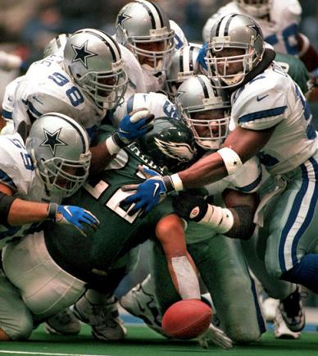
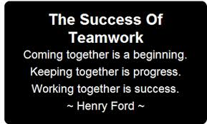

Teamwork makes the Dream Work!
Divide the Task Multiply the Success!!

Slide 7





HALF TIME!

Slide 8
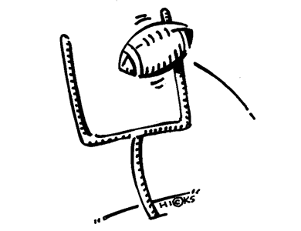
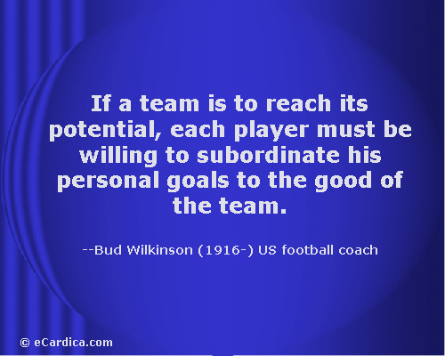
There is no I in Team!

Slide 9


Season in Review!
What is a Team?
How can teamwork help you and your Chapter?
What happens when everyone works together as a team?
What does being a team mean to you?

Slide 10
Questions?!
Allison Butts
South District Sentinel
Contact Information
251-225-0792 (Cell)
abutts@alabamaffa.org

