Slide 1
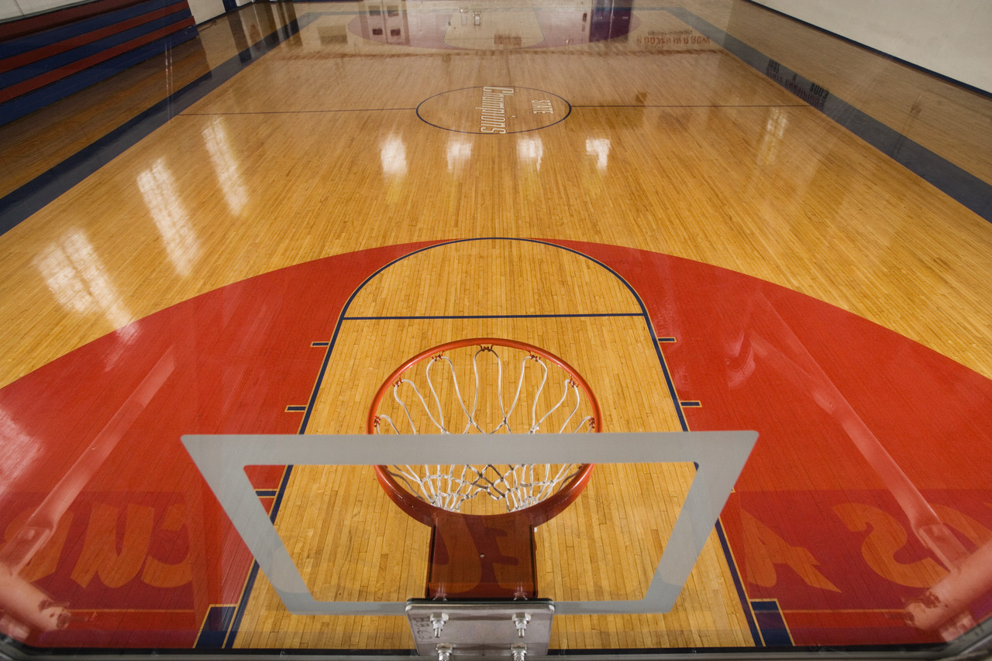
Shoot for 3 with your SAE
By Clay Tew
South District Treasurer

Slide 2
Types of SAE’s
Exploratory
Research
Placement
Entrepreneurship

Slide 3
Exploratory
Appropriate for beginning students or advanced students
Designed primarily to help students become literate in agriculture
Designed to help students become aware of possible career areas in agriculture

Slide 4
Research
Experimental-where a student plans and conducts a major agricultural experiment using the scientific process
Non- Experimental (analytical)- where a student chooses an agricultural problem not suited to experimentation and designs a plan to investigate and designs a plan to investigate and analyze the problem

Slide 5
Placement
Involves the placement of students on farms, agricultural business, school laboratories, or in community facilities to provide a “learning by doing” environment

Slide 6
Entrepreneurship
Involves the student planning, implementing, operating and assuming financial risks on a farming activity or an agricultural business

Slide 7
SAE Grants
90 grants given annually ($1,000 each)
Total of $90,000

Slide 8
Benefits
Responsibility
Skills
Money
Awards

Slide 9
Proficiency Awards
Paper application based on SAE and FFA involvement (49 categories)

Slide 10
1. Agricultural Communications
2. Agricultural Education
3. Agricultural Mechanics Energy Systems
4. Agricultural Mechanics Fabrication and Design
5. Agricultural Mechanics Repair and
Maintenance - Entrepreneurship
6. Agricultural Mechanics Repair and
Maintenance - Placement
7. Agricultural Processing
8. Agricultural Sales - Entrepreneurship
9. Agricultural Sales Placement
10. Agricultural Services
11. Agriscience Research - Animals Systems
12. Agriscience Research - Integrated Systems
13. Agriscience Research - Plant Systems
14. Beef Production - Entrepreneurship
15. Beef Production - Placement
16. Dairy Production - Entrepreneurship
17. Dairy Production - Placement
18. Diversified Agriculture Production
19. Diversified Crop - Entrepreneurship
20. Diversified Crop – Placement
21. Diversified Horticulture
22. Diversified Livestock Production
23. Emerging Agricultural Technology
24. Environmental Science and Natural Resources
Management
25. Equine Science - Entrepreneurship
26. Equine Science - Placement
27. Fiber and/or Oil Crop Production
28. Food Science and Technology
29. Forage Production
30. Forest Management
31. Fruit Production
32. Goat Production
33. Grain Production - Entrepreneurship
34. Grain Production - Placement
35. Home and/or Community Development
36. Landscape Management
37. Nursery Operations
38. Outdoor Recreation
39. Poultry Production
40. Sheep Production
41. Small Animal Production and Care
42. Specialty Animal Production
43. Specialty Crop Production
44. Swine Production - Entrepreneurship
45. Swine Production - Placement
46. Turf Grass Management
47. Vegetable Production
48. Veterinary Science
49. Wildlife Management

Slide 11
Agriscience Fair
6 categories
Animal Systems
Environmental Services/Natural Resource Systems
Food Products and Processing Systems
Plant Systems
Power, Structural, and Technical Systems
Social Systems
4 Divisions
Division 1-Individuals in grades 7, 8, and 9
Division 2-Individuals in grades 10, 11, and 12
Division 3-Teams in grades 7, 8, and 9
Division 4-Teams in grades 10, 11, and 12

Slide 12
Courtesy Corps
National Convention- Louisville, KY
Registration begins Mid-August

Slide 13
Opportunities
WLC(Washington Leadership Conference)-choose on of six weeks
ALFA Youth Leadership Conference- Columbiana, AL
JLDC(Joint Leadership Development Conference)-Birmingham, AL

